Slide 1
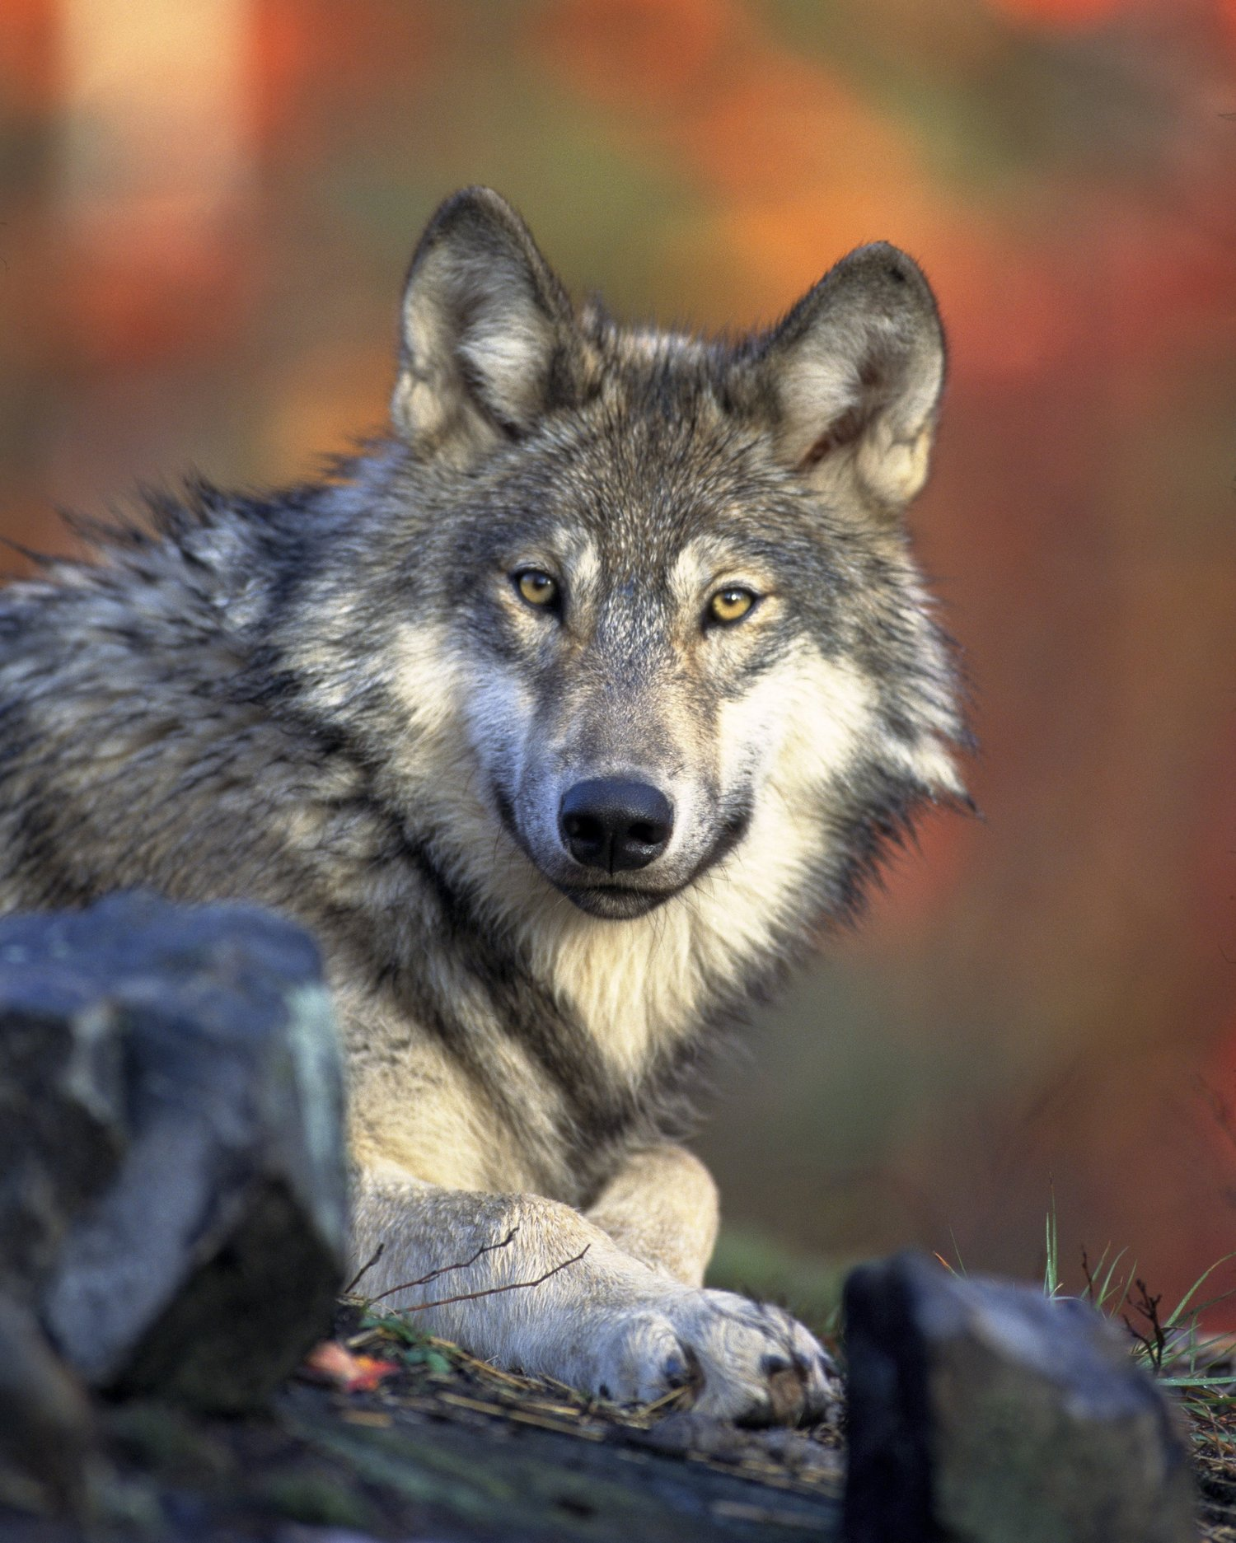
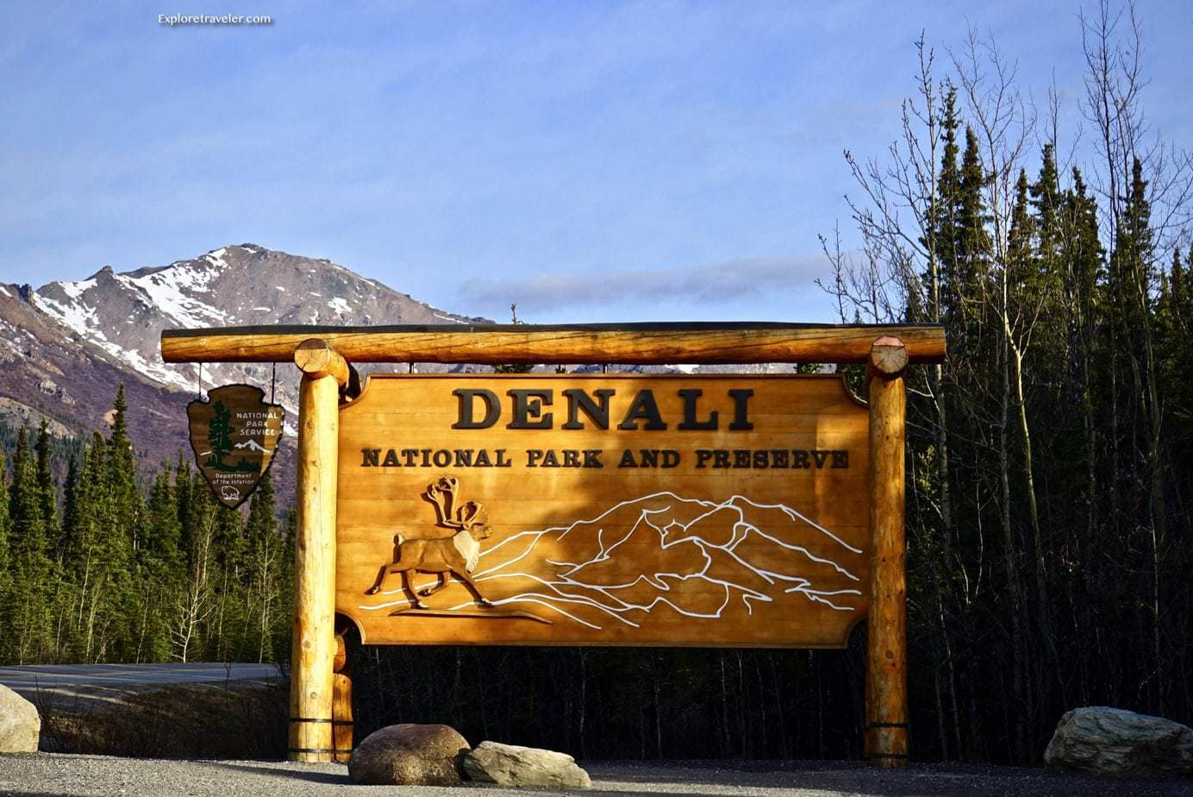
Wolf Populations in Denali National Park in Alaska
By: Kelsea Figaro
CMP262-Final Project

Slide 2
Introduction
Dataset looks at yearly wolf populations in Denali National Park in Alaska
In this analysis:
  Yearly increase/decrease in wolf populations in the park
  Correlation between number of wolfpacks monitored and area (in km) monitored

Slide 3
Who would value this information?
Wildlife biologists whose studies focus on wolves
Wildlife agencies such as U.S Fish and Wildlife Service (USFWS) and the Alaska Department of Fish and Game (ADF&G)
This information could be used to make decisions on how to better handle conservation for wolves in the park and surrounding areas

Slide 4
Methodology
Data used: Denali Wolf Population Data, 1986-2024 from data.gov
Published by the National Park Service
Data was downloaded as an CSV file then read into Jupyter Notebooks where cleaning, plotting, and analyzing was done

Slide 5
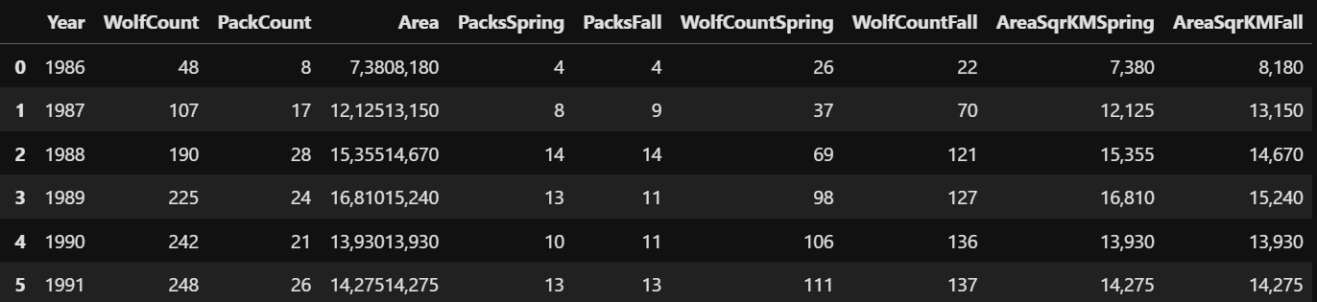
Methodology: The data
Columns used: Year, WolfCount(spring and fall added together), PackCount(spring and fall added together), PacksSpring, PacksFall, WolfCountSpring, WolfCountFall, AreaSqrKMSpring, and AreaSqrKMFall

Slide 6
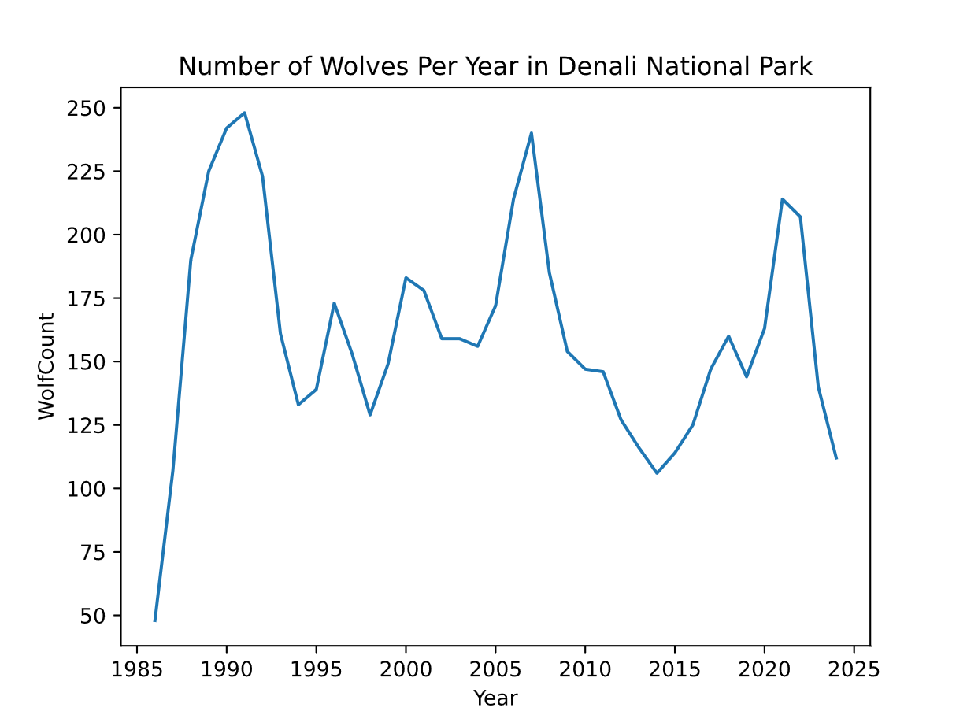
Result: Has there been an increase or decrease of wolf population in the park over the years?
Over the years, there were both increases in population and decreases of population.
What has caused these increases and decreases in
in population?
More data is required
Notable changes:
Large increase from 1986 to 1991
Population has been in decline since 2021

Slide 7
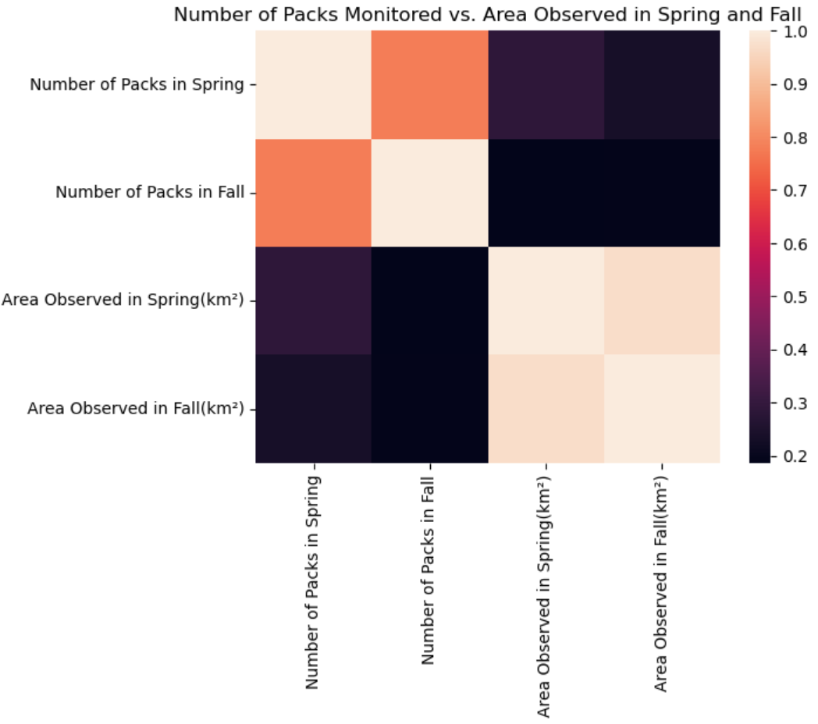
Result: Correlation between number of wolf packs monitored in the spring and fall
Neither spring nor fall have strong correlation
Spring has slightly stronger positive correlation
then the fall
Overall, the amount of area observed doesn’t appear
to play a major role in the number of wolf packs
counted

Slide 8
Future Questions
Since the data set focused only on the population of the wolves, it has led to some additional questions:
What was the prey availability like over the years and did that have any effect on the wolf populations
Were there any environmental factors (such as weather, water availability, disease, hunting, etc) that played a role in the population of individuals and packs?

Slide 9
The Appendix

Slide 10
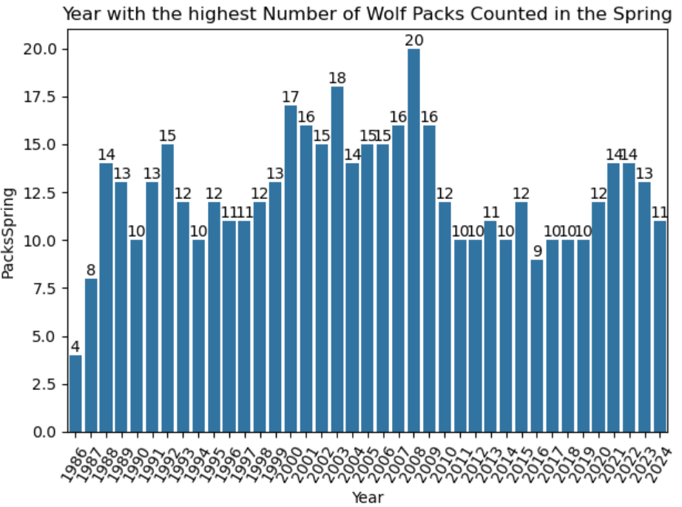
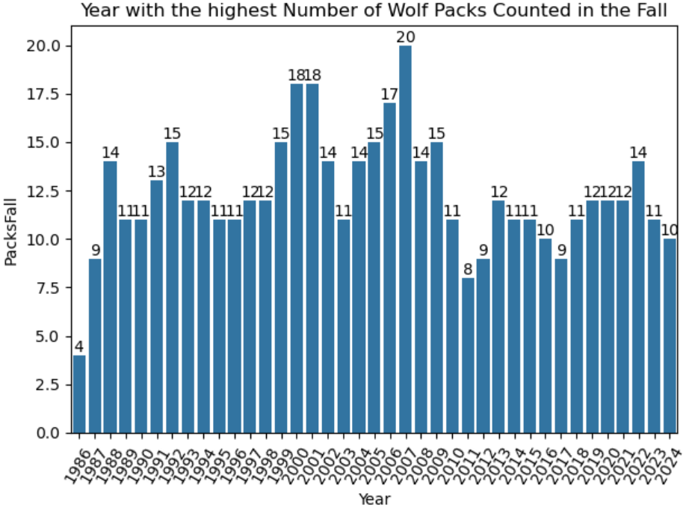
Appendix- Wolf packs in the spring/fall by year

Slide 11
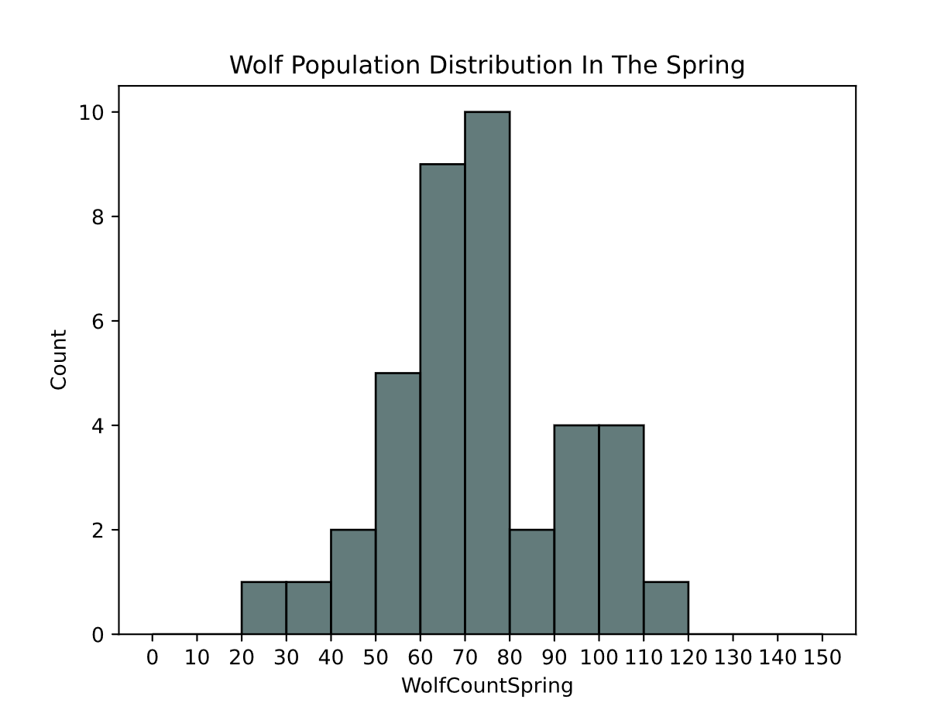
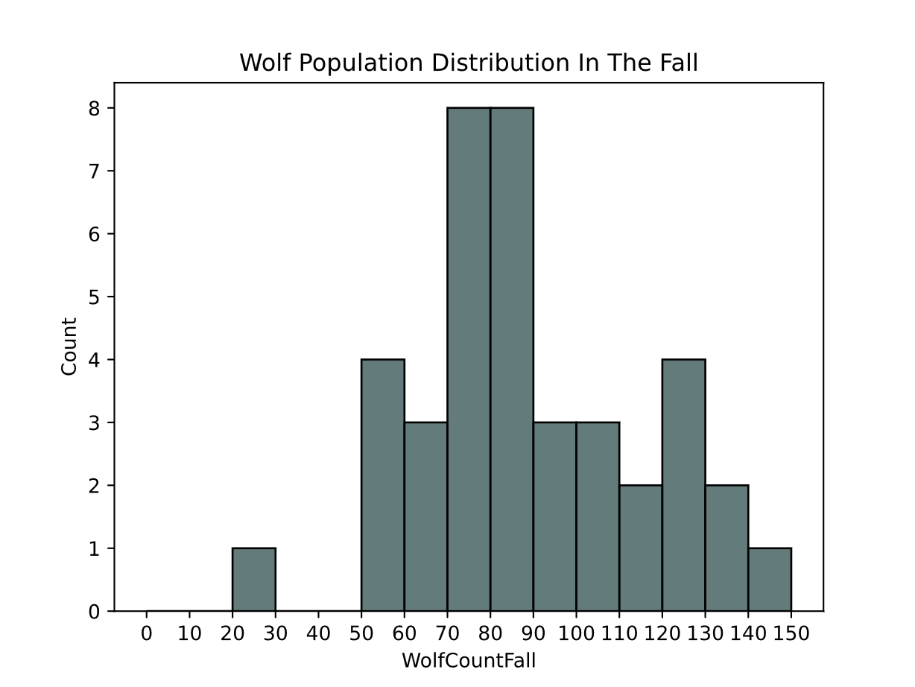
Appendix: Wolf Population Distribution in spring and fall

Slide 12
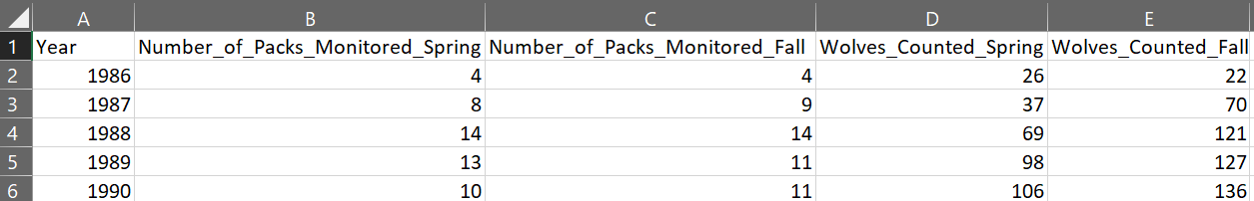
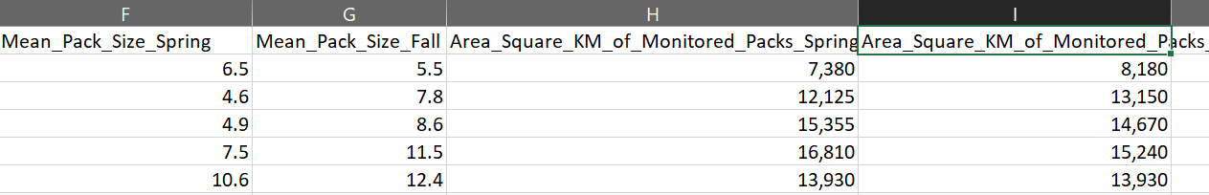
Appendix- Original data

Slide 13
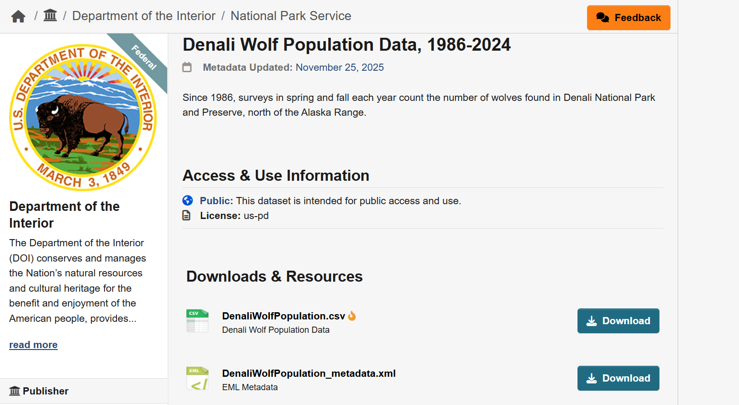
Appendix- description on website

Slide 14
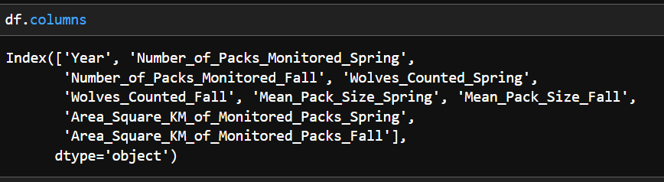
Appendix- original column names

Slide 15
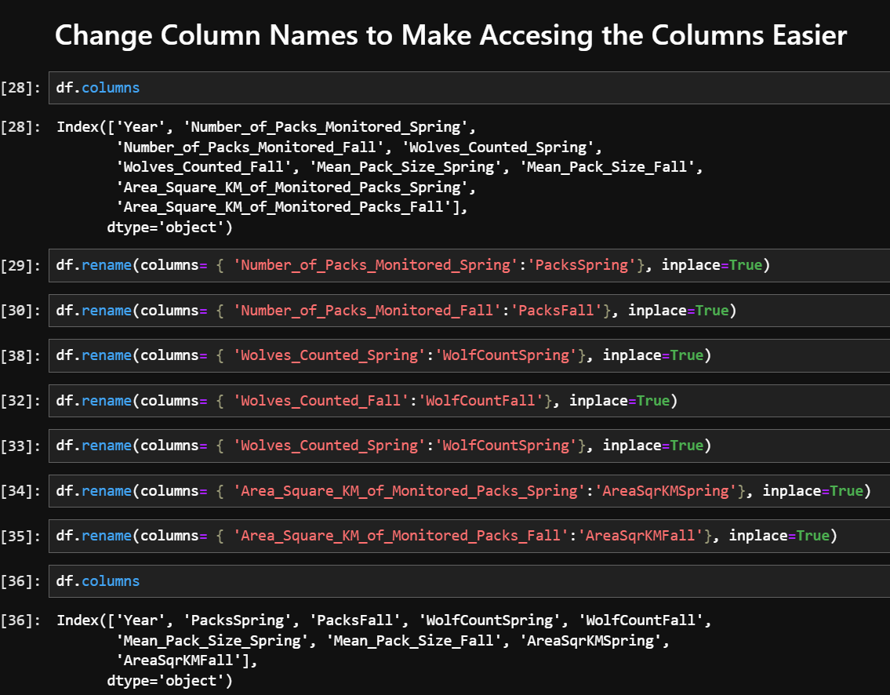
Appendix- change column names

Slide 16
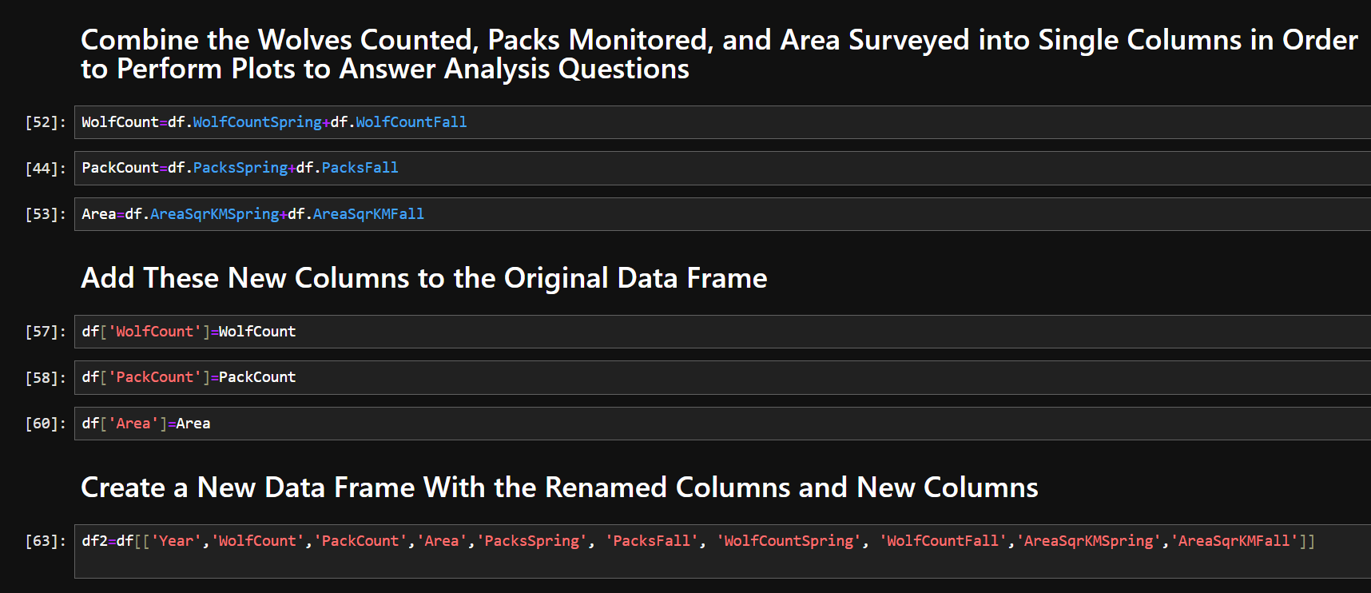
Appendix- column concatenation

